Slide 1
Academic Writing
Task2 话题
教育类+ 社会类

Slide 2

教育类话题
功能（目的）
personal ambition
contribution to society
问题
tuition fees
bad behaviours
gap year
方式
group teaching
mixed or single-sex school
self-learning and lectures
competition and cooperation
online and traditional learning
谁来教
parents/ family
schools/ teachers
peers
government
media
内容
theory
practical/ vocational skills
science
art
unpaid/ voluntary work

Slide 3
谁来教---- 相关考题回顾
2019-3-23
Once children start school, teachers have more influence on their intellectual and social development than parents do. To what extent do you agree or disagree?
2019-11-16 The family has a great influence on children’s development, but the influence from outside of the home plays a bigger part in children’s life. Discuss both these views and give your opinion.
2021.12. 30 Some people believe that schools are no longer necessary, because students can get so much information through the Internet, and study just as well at home. To what extent do you agree or disagree?

Slide 4
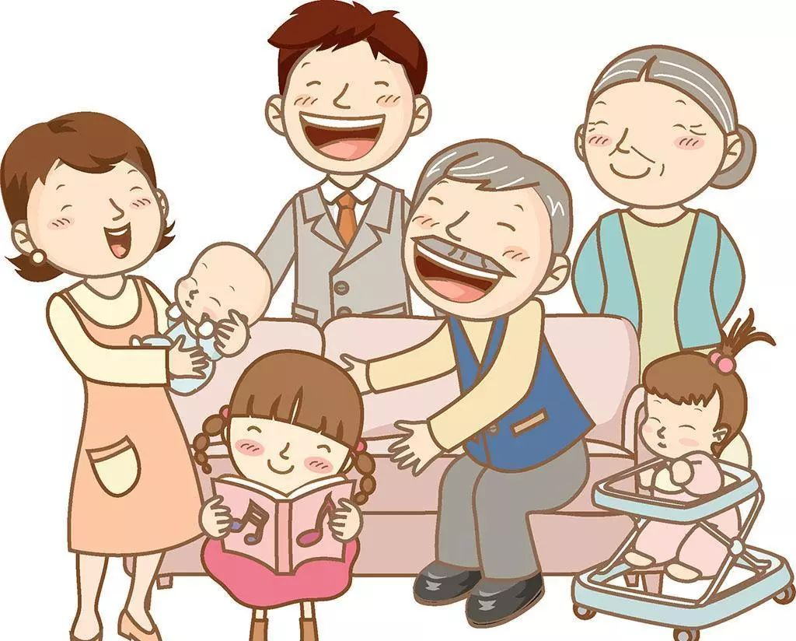
谁来教
家庭：
Parents are a child’s first teachers ---- behaviors, habits, moral code.etc
home schooling---- caring, concerned teaching and supervision
Not linked just to "schooling" but to life itself ---- foster forgiveness, mercy

Slide 5
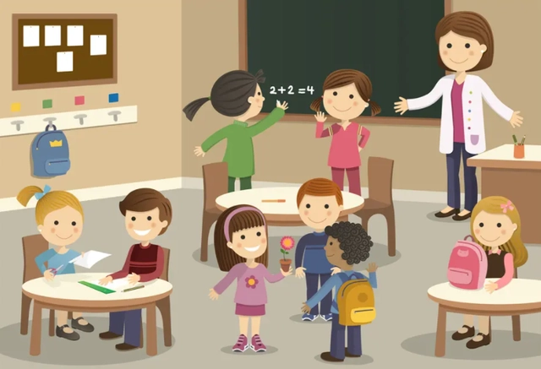
谁来教
学校：prepare young people for their future
impart professional knowledge
help students learn to think critically, solve problems, and complete tasks independently
provide a safe place to learn and grow together
give children a chance to socialize

Slide 6
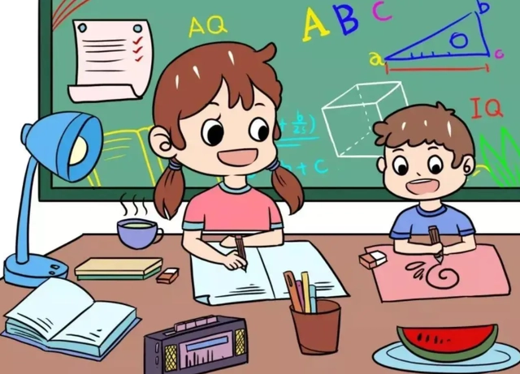

谁来教
其他：
peer pressure
social media

Slide 7
教育目的---- 相关考题回顾
Some people believe that university students should pay all the costs of studies because university education only benefits students themselves not the society as a whole. To what extent do you agree or disagree?
2021.12. 25
Some people think the main purpose of schools is to turn the children into good citizens and workers rather than to benefit them as individuals. To what extent do you agree or disagree? 2022.06.16
Some people believe that the purpose of education is to prepare individuals to be useful to society. Others say the purpose of education is to achieve personal ambitions. Discuss both views and give your own opinion. 2023.9.2

Slide 8

教育功能（目的）---- 社会/国家
disseminate values, beliefs, and attitudes that are important to society
help people walk with the development of the world
offer individuals that make contributions meaningfully
keep the country competitive
传播意识形态
融入社会
提供人才
国家竞争力
Notes:
knows no bound 知识无界限，无尽头

Slide 9


教育功能（目的）---- 个人
物质角度（能力）：
发挥潜力
全面发展能力
为将来打基础
development of inborn potential
an all-round development of the individual
lay foundation for the future
精神角度
（道德性格）：
改变行为模式
塑造价值观
增强适应力
建立热情
modify behaviour
shape values
enhance adaptability
build passion/enthusiasm

Slide 10

教育功能（目的）---- 个人
德：
智：
体：
美：
劳：
提高道德标准
improve moral standard
学习理论知识
acquire theoretical knowledge
develop independent and critical thinking
enhance analyzing skills and problem solving ability
improve communication and social skills
培养独立思考，批判性思维
加强分析和解决问题的能力
提高人际交流技巧和社交技能
提高身体素质
养成良好的生活习惯
develop physical fitness
form a healthy lifestyle
提升文化修养
培养对艺术的欣赏水平
self-cultivation an appreciation of art
学习实用知识/加强动手能力
有助于就业前景
gain practical skills
improve career prospects

Slide 11
教育内容---- 相关考题回顾
Some people think it is important for all children to learn history at school. Others believe that other subjects like science and mathematics are more relevant to children’s development today. Discuss both views and give your opinion. 2019-8-1
Some people believe that university education should focus on the skills of employment for the future. Others think university education should focus on academic study only. Discuss both views and give your opinion. 2021.06.12
Parents should encourage children to spend less time studying and more time doing physical activities. To what extent do you agree or disagree? 2021.2.20.

Slide 12
教育内容
Categorise the subjects below into three groups:
Arts and Humanities(AH), Social Sciences(SS) or Science and Technology(ST)
ST
mathematics____
philosophy ____
chemistry____
business studies ____
media studies____
English literature____
sociology____
law ____
biology____
engineering____
history____
psychology ____
SS
AH
SS
ST
ST
SS
ST
AH
AH
AH
SS

Slide 13
艺术, 体育, 文史类
艺术的重要性：
unleash emotions ---- express themselves and live out their dreams.
maintain mental health---- deal with tough times and connect with one another on a deeper level
increase creativity ---- impress people and inspire ideas
体育的重要性：
enhance the freshness and vitality of the mind
improve physical fitness
maintain good habits
文史的重要性：
unlock our minds and perception about the world
develops critical thinking skills
understand other cultures and beliefs
cultivate wisdom

Slide 14
数学理科类
数学的重要性：
quicken our minds
develop analytical and logical thinking ---- learn how to analyze huge amounts of data and determine what’s good evidence
express our thoughts and ideas with clarity, coherence, and precision
be very useful in understanding how and why things work
enable comprehension and expression of complicated issues
form the foundation of other more practical academic subjects
科学的重要性：
develop practical skills ---- science careers pay well/increase common sense
transform how humans live ---- scientific inventions like computers, satellites, x-rays
increase our lifespan
unlock the mysteries of the universe

Slide 15
教育方式---- 相关考题回顾
2016-2-13
In some countries, there has been an increase in the number of parents who educate their children themselves at home instead of sending them to school. Do you think the advantages of this outweigh the disadvantages?
2018-12-8
Some people think that schools should select students according to their academic abilities while others believe that it is better to have students with different abilities study together. Discuss both views and give your own opinion.
2018-9-29
Team / group activities can teach more important skills for life than those activities which are played alone. To what extent do you agree or disagree?

Slide 16
教育方式
mixed-sex school
advantage
students receive more access to diversity
co-educational environments offer equal opportunities to both genders
prepare students for the real world ----develop better communication skills
disadvantage
create problems with sexual distraction
face a risk of encouraging intimate relationships at an early age
encounter issues with their self-esteem or confidence

Slide 17
教育方式
online learning
advantage
give you freedom to create a work-study balance
provide a peaceful and agreeable learning environment
lower cost
provides an alternative to paper-based learning --- eco-friendly
disadvantage
have more difficulty getting in touch with your instructor --- feedback/confusion
difficult to build relationships of any kind
Technical Issues

Slide 18
Some people think that all university students should study whatever they like. Others believe that they should only be allowed to study subjects that will be useful in the future, such as those related to science and technology. Discuss both these views and give your own opinion.
教育类范文
Sample answer（Simon ）
首段：
People have different views about how many choices students should have with regard to what they can study at university.
While some argue that it would be better for students to be forced into certain key subject areas, I believe that everyone should be able to study the course of their choice.

Slide 19
Some people think that all university students should study whatever they like. Others believe that they should only be allowed to study subjects that will be useful in the future, such as those related to science and technology. Discuss both these views and give your own opinion.
教育类范文
主体段1 ---让步反方观点：
There are various reasons why people believe that universities should only offer subjects that will be useful in the future.
解释：
They may assert that university courses like medicine, engineering and information technology are more likely to be beneficial than certain art degrees.
举例+结果----个人角度：
From a personal perspective, it can be argued that these courses provide more job opportunities, career progression, better salaries, and therefore an improved quality of life for students who take them.
举例+结果----社会角度：
On the societal level, by forcing people to choose particular university subjects, governments can ensure that any knowledge and skill gaps in the economy are covered. Finally, a focus on technology in higher education could lead to new inventions, economic growth, and greater future prosperity.

Slide 20
Some people think that all university students should study whatever they like. Others believe that they should only be allowed to study subjects that will be useful in the future, such as those related to science and technology. Discuss both these views and give your own opinion.
教育类范文
主体段2 ---反驳，陈述己方观点：
In spite of these arguments, I believe that university students should be free to choose their preferred areas of study.
论点1：
In my opinion, society will benefit more if our students are passionate about what they are learning.
论点2：
Besides, nobody can really predict which areas of knowledge will be most useful to society in the future, and it may be that employers begin to value creative thinking skills above practical or technical skills.
结果：
If this were the case, perhaps we would need more students of art, history and philosophy than of science or technology.
总结段：
In conclusion, although it might seem sensible for universities to focus only on the most useful subjects, I personally prefer the current system in which people have right to study whatever they like.

Slide 21
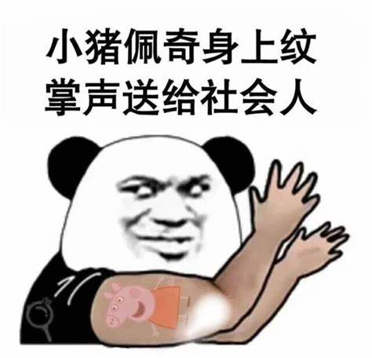
社会类话题
人的问题
老龄化
老人和年轻人
男人和女人
休产假
晚育
城市问题
城市化
农村和城市
交通拥堵
修建筑还是公园

Slide 22
社会类相关考题回顾
2022.07.09 It is difficult for people living in cities to get enough physical exercise. What are the causes and what solutions can be taken to solve the problem ?
2022.06.11
Today people live longer after retiring from work. What problems does this cause for individuals and society? What can be done to address these problems?
2022.05.28
The use of cars and motorcycles causes transportation difficulty in cities. Why do people continue to use cars and motorcycles in cities? What is the best way to solve this problem?
2021.05.08
The best way to improve road transport safety is to let the drivers have a test each year. To what extent do you agree or disagree?
2021.03.06
In some countries around the world men and women are having children later in life. What are the reasons for this development? What are the effects on society and family life?

Slide 23
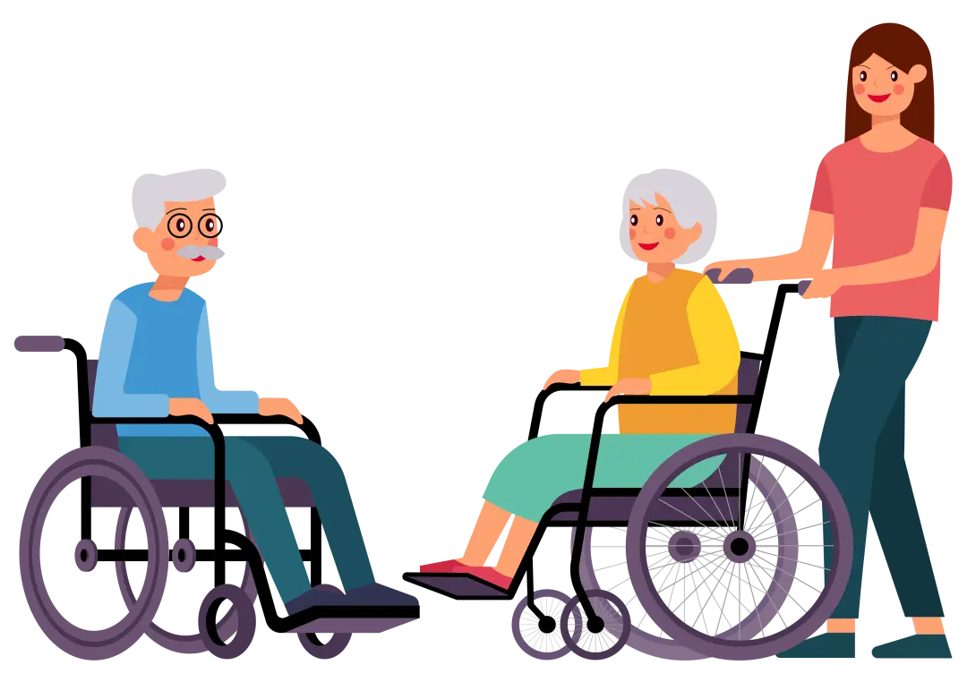
老龄问题
老龄化的好处 ：
1 ) 老年人退休可能参加社区服务回馈社会
contribute free labour to community and governments projects after retirement.
2 ) 老年人更有经验
more experienced than younger people.
3 ) 老年人可以将文化传承
helps maintain the cultures and religions of countries by passing down their knowledge to the young
老龄化的坏处 ：
1 ) 增加政府医疗和养老金方面支出
increase government spending on health care and pensions.
2) 减少政府税收
A lower proportion of people in work means lower tax revenues.

Slide 24

城市问题
城市化的好处 ：
1 ) 人们的精神生活和物质生活都提高了。
A larger number of people are living at a higher standard with regard to both material and spiritual aspects.
2 ) 吸引投资。
Governments have focused on making the cities look good for investment.
3 ) 有利于学校建设。
The schools in cities tend to be better equipped and the students also have access to more and better information.

Slide 25
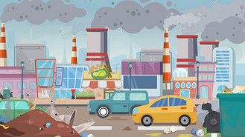
城市问题
城市化的弊端 ：
1 ) 加重环境问题
Pollution in cities is greater due to traffic, congestion of vehicles and poor collection of waste
2 ) 对农村发展不利。
It has a negative influence on the sustainable development of the rural areas.
3 ) 对当地的传统及文化不利。
It is detrimental to traditions and culture there.
4 ) 很多人涌入城市 ，交通和住房压力大。
With too many people swarming into cities, traffic pressure and housing pressure are bound to increase.

Slide 26
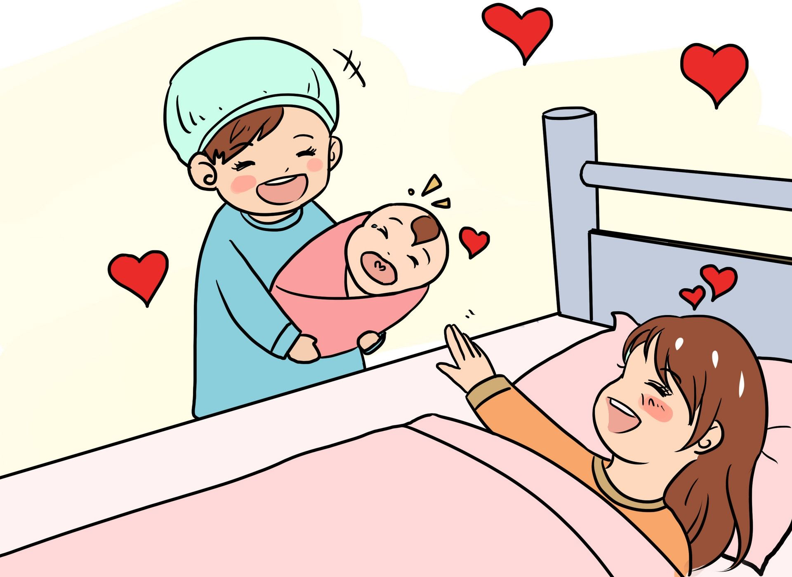
性别问题
晚育的原因 ：
1 ) 普遍接受教育的时间变长。
Longer years of education delay marriage, and therefore delay parenthood.
2 ) 生活成本变高。
The escalating cost of living.
晚育的缺点 ：
1 ) 晚育可能带来生育方面的问题。
Certain fertility issues that may come with advanced maternal age
晚育的优点 ：
1 ) 经济方面。
Financially prepared before taking on parental roles.
2 ) 父母心理方面。
More life experience that helps them to raise children with wisdom.

Slide 27

性别问题
支持排斥男性或者女性从事某一工作 ：
1 )女性不太可能承受长期的锻炼和操练 ，所以她们不适合耗费体力的工作。
With very few exceptions, women are not possibly able to withstand the long hours of exercises and drills, so they are not suitable for physically demanding work.
2 ) 大多数女性害怕暴力或者血腥 ，所以参军类工作不适合她们。
Some jobs such as joining armies are unacceptable to most women because women generally do not like to see violence, let alone blood.
3 )面对一个充满异性的世界 ，他们也许会遭遇怀疑或者受到关注。他们会觉得格格不入。
Being faced with a world full of the opposite sex, they may be met with concern and suspicion from their neighbours and friends. They may feel completely at odds with the rules and values which are designed predominantly for the other sex.

Slide 28

性别问题
不应该排斥男性或者女性从事某一工作 ：
1 ) 越来越多的女性在学业和工作上比男性出色。
There are successful women who do better at school and university, and increasingly in business.
2 ) 排斥某一性别的人威胁到开放民主的生活方式，及人的自由。
Excluding a certain gender threatens the liberal, democratic way of life that we have and poses a threat to freedom.
3 ) 不同的性别可以带来不同的思路和解决方案。
Men and women can bring slightly different perspectives and approaches to a job.
4 )丈夫和妻子可以自由选择工作的话，一个家庭可以获得双份收入。而双份收入有利于缓解经济压力。
Given that the husband and the wife can choose their jobs freely, a family benefits from dual incomes which help to ease the financial pressure of setting up a house and establishing a reasonable standard of living.

Slide 29
2019.11.07
In some cultures, the old age is highly valued, while in some cultures youth is highly valued. Discuss both views and give your own opinion.
中心句：Young people and old people both have their own advantages.
分论点1：The youth are more valued in some cultures because they are creative and energetic.
分论点2：Some cultures respect the old as they attach much importance to traditional values and experiences.

Slide 30

职场：年轻人 VS 老年人
年轻人优势：
have easier access to the latest fashion and lifestyles;
able to adapt to new technologies or ideas;
their vision and adventurous spirit offer important competitive power in these pioneering industries;
physically strong to remain active at work or even work overtime

Slide 31
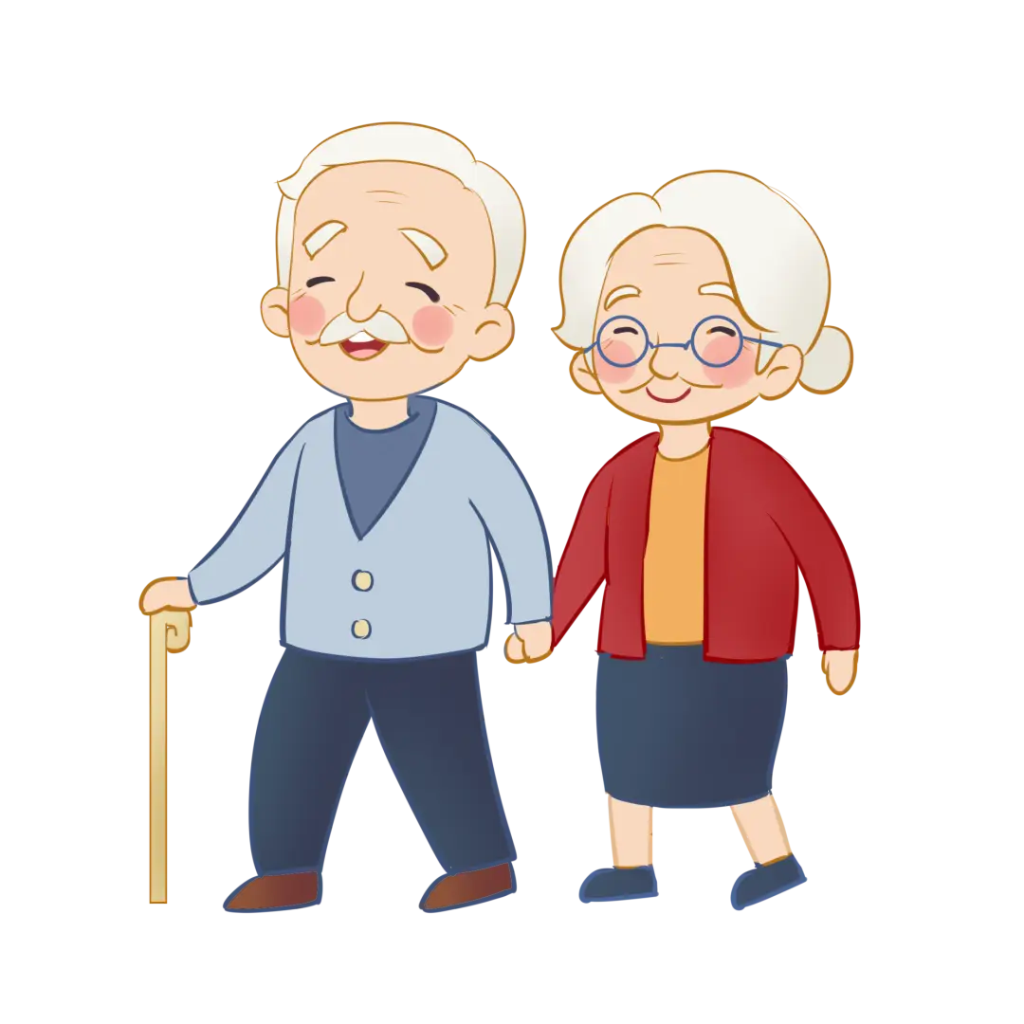
职场：年轻人 VS 老年人
老年人优势：
1）they are more mature mentally as well as emmotionally, who are good at communicating with team members of different ages and are calm when dealing with difficulties and crises;
2）their experience may continue to be valuable to their employers. A good example can be seen in one scheme in the UK in which elder employees remained in work as mentors for younger employees.

Slide 32
practice
2019.05.04
The increasing use of technology in the workplace has made it easier for young people to find jobs and harder for older people to do so. To what extent do you agree or disagree?
中心句：The young are not always in the better position to find a job simply because they better at new technologies.
分论点1：Many older people can actually get used to using technology skills if they are given the opportunity to do so.
分论点2：Older people are able to combine what they have learned in technology with seasoned communication skills in real life.

Slide 33
In the developed world, average life expectancy is increasing. What problems will this cause for individuals and society? Suggest some measures that could be taken to reduce the impact of ageing populations
社会类范文
Sample answer（Simon ）
首段：
It is true that people in industrialised nations can expect to live longer than ever before.
Although there will undoubtedly be some negative consequences of this trend, societies can take steps to mitigate these potential problems.

Slide 34
In the developed world, average life expectancy is increasing. What problems will this cause for individuals and society? Suggest some measures that could be taken to reduce the impact of ageing populations
社会类范文
主体段1 ---分析后果：
As people live longer and the populations of developed countries grow older, several related problems
can be anticipated.
解释：
The main issue is that there will obviously be more people of retirement age who will be eligible to receive a pension.
结果：
The proportion of younger, working adults will be smaller, and governments will therefore receive less money in taxes in relation to the size of the population.
进一步结果：
In other words, an ageing population will mean a greater tax burden for working adults. Further pressures will
include a rise in the demand for healthcare, and the fact young adults will increasingly have to look
after their elderly relatives.

Slide 35
In the developed world, average life expectancy is increasing. What problems will this cause for individuals and society? Suggest some measures that could be taken to reduce the impact of ageing populations
社会类范文
主体段2 ---解决方案：
There are several actions that governments could take to solve the problems described above.
方案1：
Firstly, a simple solution would be to increase the retirement age for working adults, perhaps from 65 to 70.
解释：
Nowadays, people of this age tend to be healthy enough to continue a productive working life.
方案2：
A second measure would be for governments to encourage immigration in order to increase the number of
working adults who pay taxes.
方案3：
Finally, money from national budgets will need to be taken from other areas and spent on vital healthcare, accommodation and transport facilities for the rising numbers of older citizens.

Slide 36
In the developed world, average life expectancy is increasing. What problems will this cause for individuals and society? Suggest some measures that could be taken to reduce the impact of ageing populations
社会类范文
Sample answer（Simon ）
总结：
In conclusion, various measures can be taken to tackle the problems that are certain to arise as the populations of countries grow older.

Slide 37
Some people think it is important for all children to learn history at school. Others believe that other subjects like science and mathematics are more relevant to children’s development today. Discuss both views and give your opinion. 2019-8-1
Homework 教育类

Slide 38
完成主体段写作： 2021.03.06 In some countries around the world men and women are having children later in life. What are the reasons for this development? What are the effects on society and family life?
Homework 社会类

Slide 39

Thank you！
Any Questions

